Slide 1


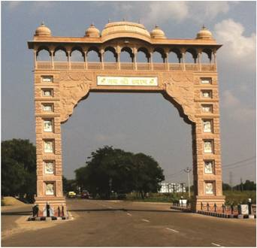

WELCOMES
YOU
AT
NEXXUS GROUP
KHATU SHYAMJI

Slide 2
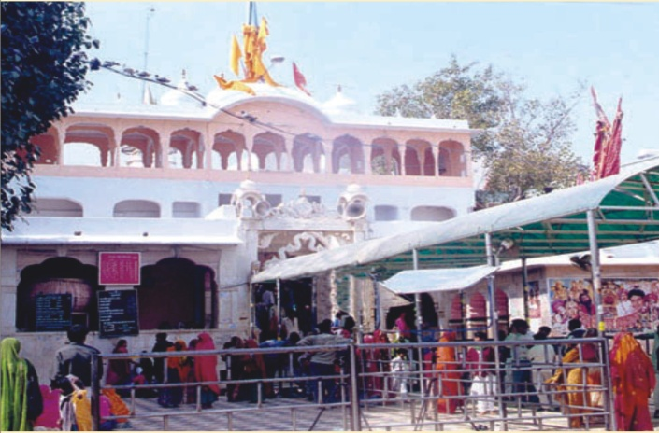

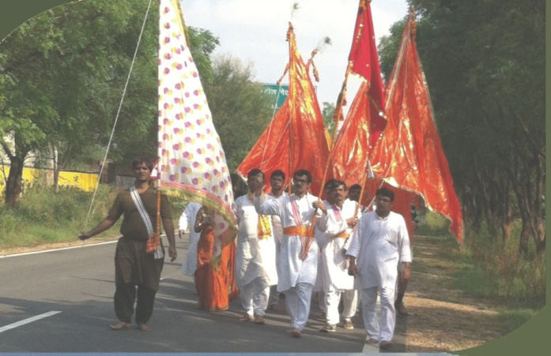
INVESTMENT BENEFITS
Khatu Shyam Ji

Slide 3
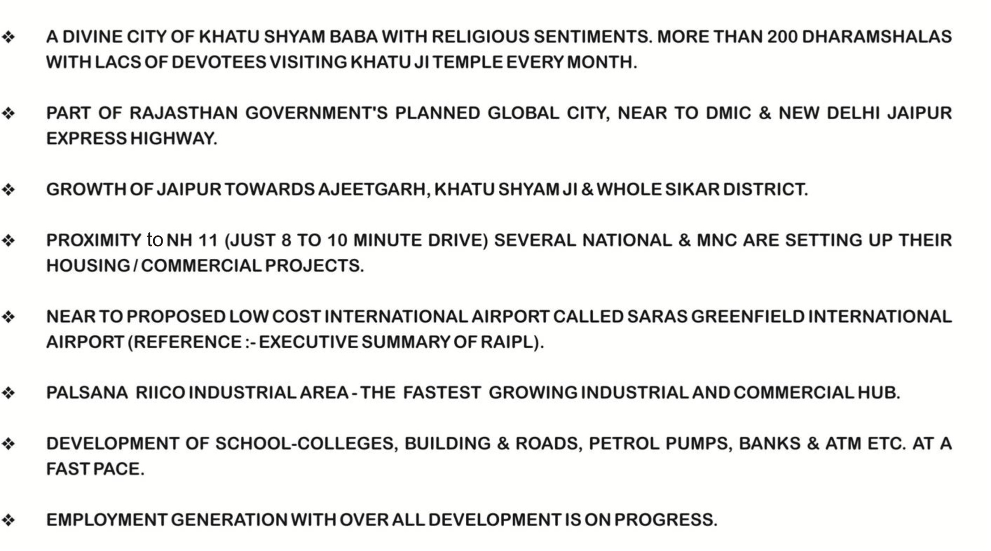
IMPORTANCE OF
NEXXUS HOMZ PROJECTS

Slide 4
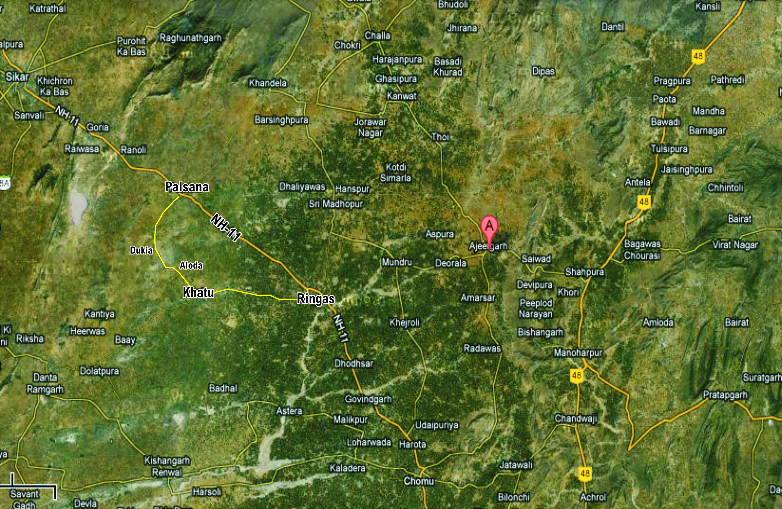
SAANWARIYA CITY ALODA - PALSANA ROAD
NEW DELHI/
GURGAON
SIKAR
AJEETGARH
NEXXUS CITY
NH - 8
SAANWARIYA CITY
SHAHPURA
Bishan Garh
JAIPUR
CHOMU

Slide 5
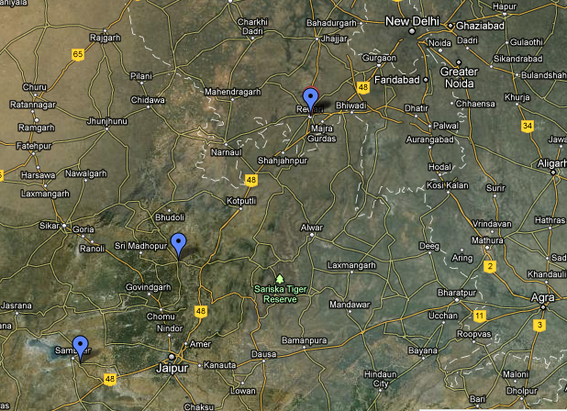
KHATU SHYAM JI – REAL ESTATE GOLDEN BELT
NEW DELHI
DADRI
GURGAON
DMIC
SIKAR
NEXXUS CITY
NH - 8
NH - 11
SHAHPURA
KHATU
AJEETGARH
JAIPUR

Slide 6

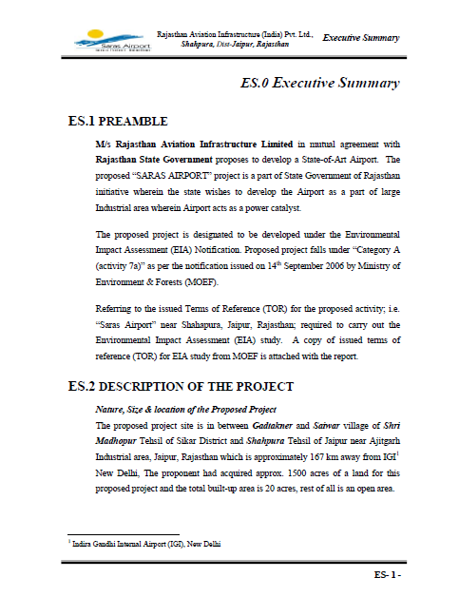

Slide 7

NEXXUS GROUP
NEXXUS GROUP PROJECTS
is one of the fastest growing company in the field of Real Estate and Building Infrastructure in North India. We have shown a towering presence in the states of Delhi, Uttrakhand and Rajasthan in this Real sector with new & upcoming projects. We have endeavour to enhance lives by creating great places to live and work. We set the standards of excellence by providing eco-friendly integrated solutions that align with our core values : honesty, innovation, teamwork, excellence, customer satisfaction, affordability and a commitment to time schedule. This is our enduring legacy to the communities we serve. At, we are committed to satisfy our customers and society by achieving success in choosing right location of Land, excellence in our quality of Lay Out-Designs, fast development and maintenance works.
In fact, Professionalism, Expertise & Continuous innovations lie at the heart of the company’s core values and this enables Nexxus Homz to constantly invent and implement across the board in conceptualization and support. Service that incorporates innovations and complete transparency has always been the Hallmark of the company’s business ethics.

Slide 8
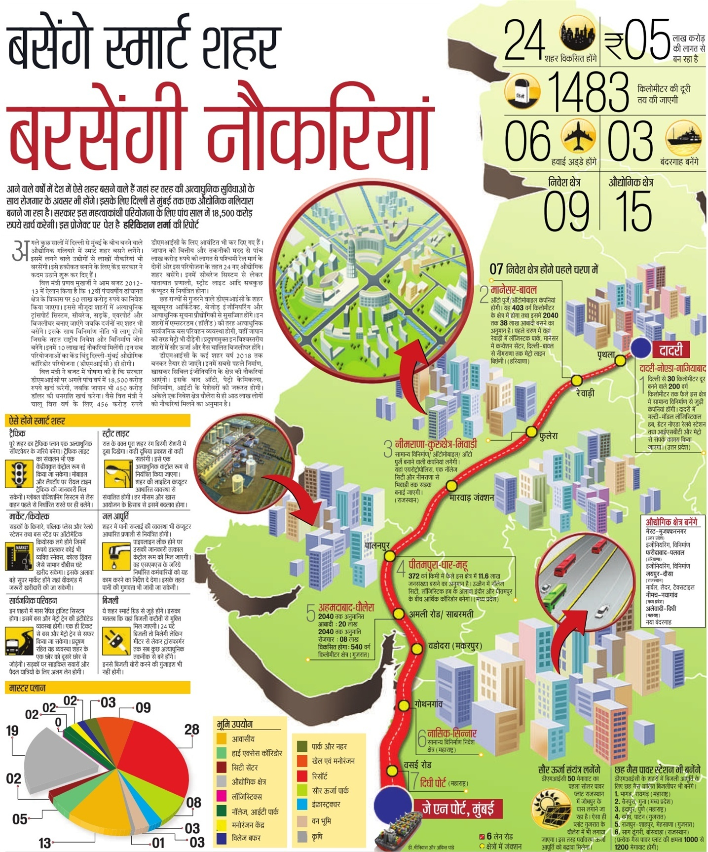

Slide 9
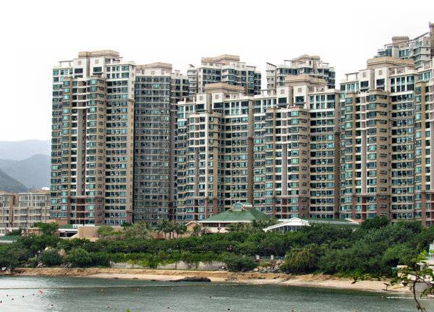

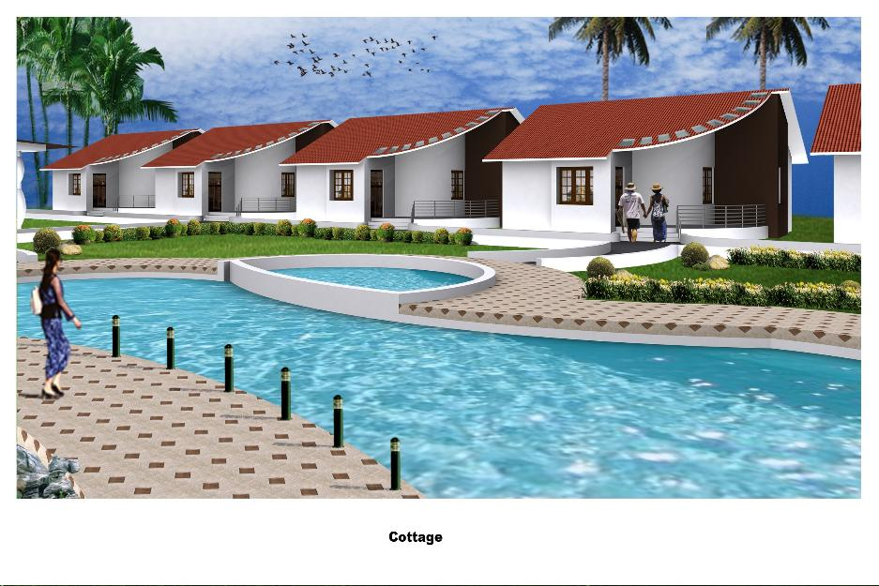
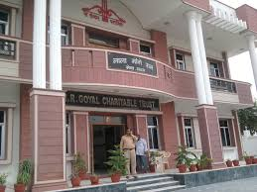

Slide 10


Slide 11
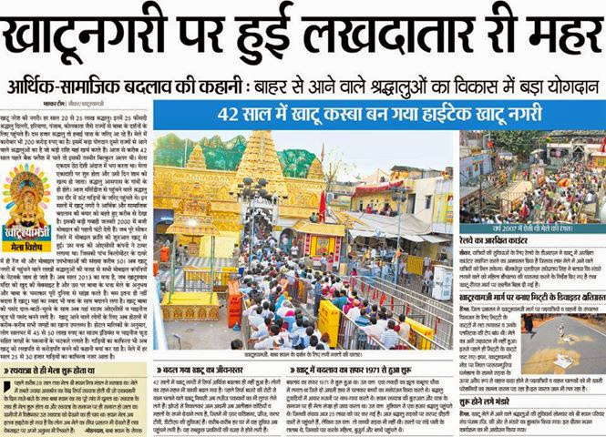

Slide 12
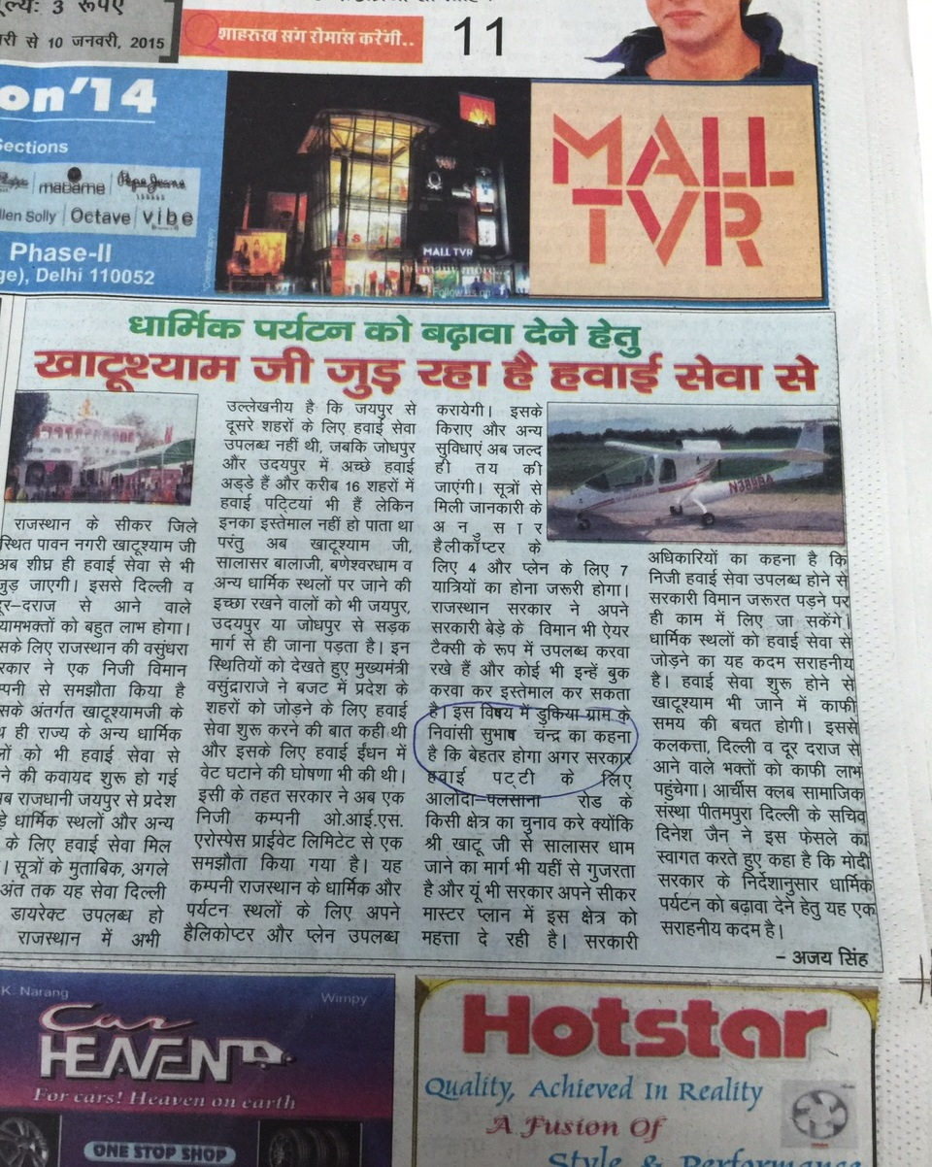

Slide 13


Slide 14


Slide 15
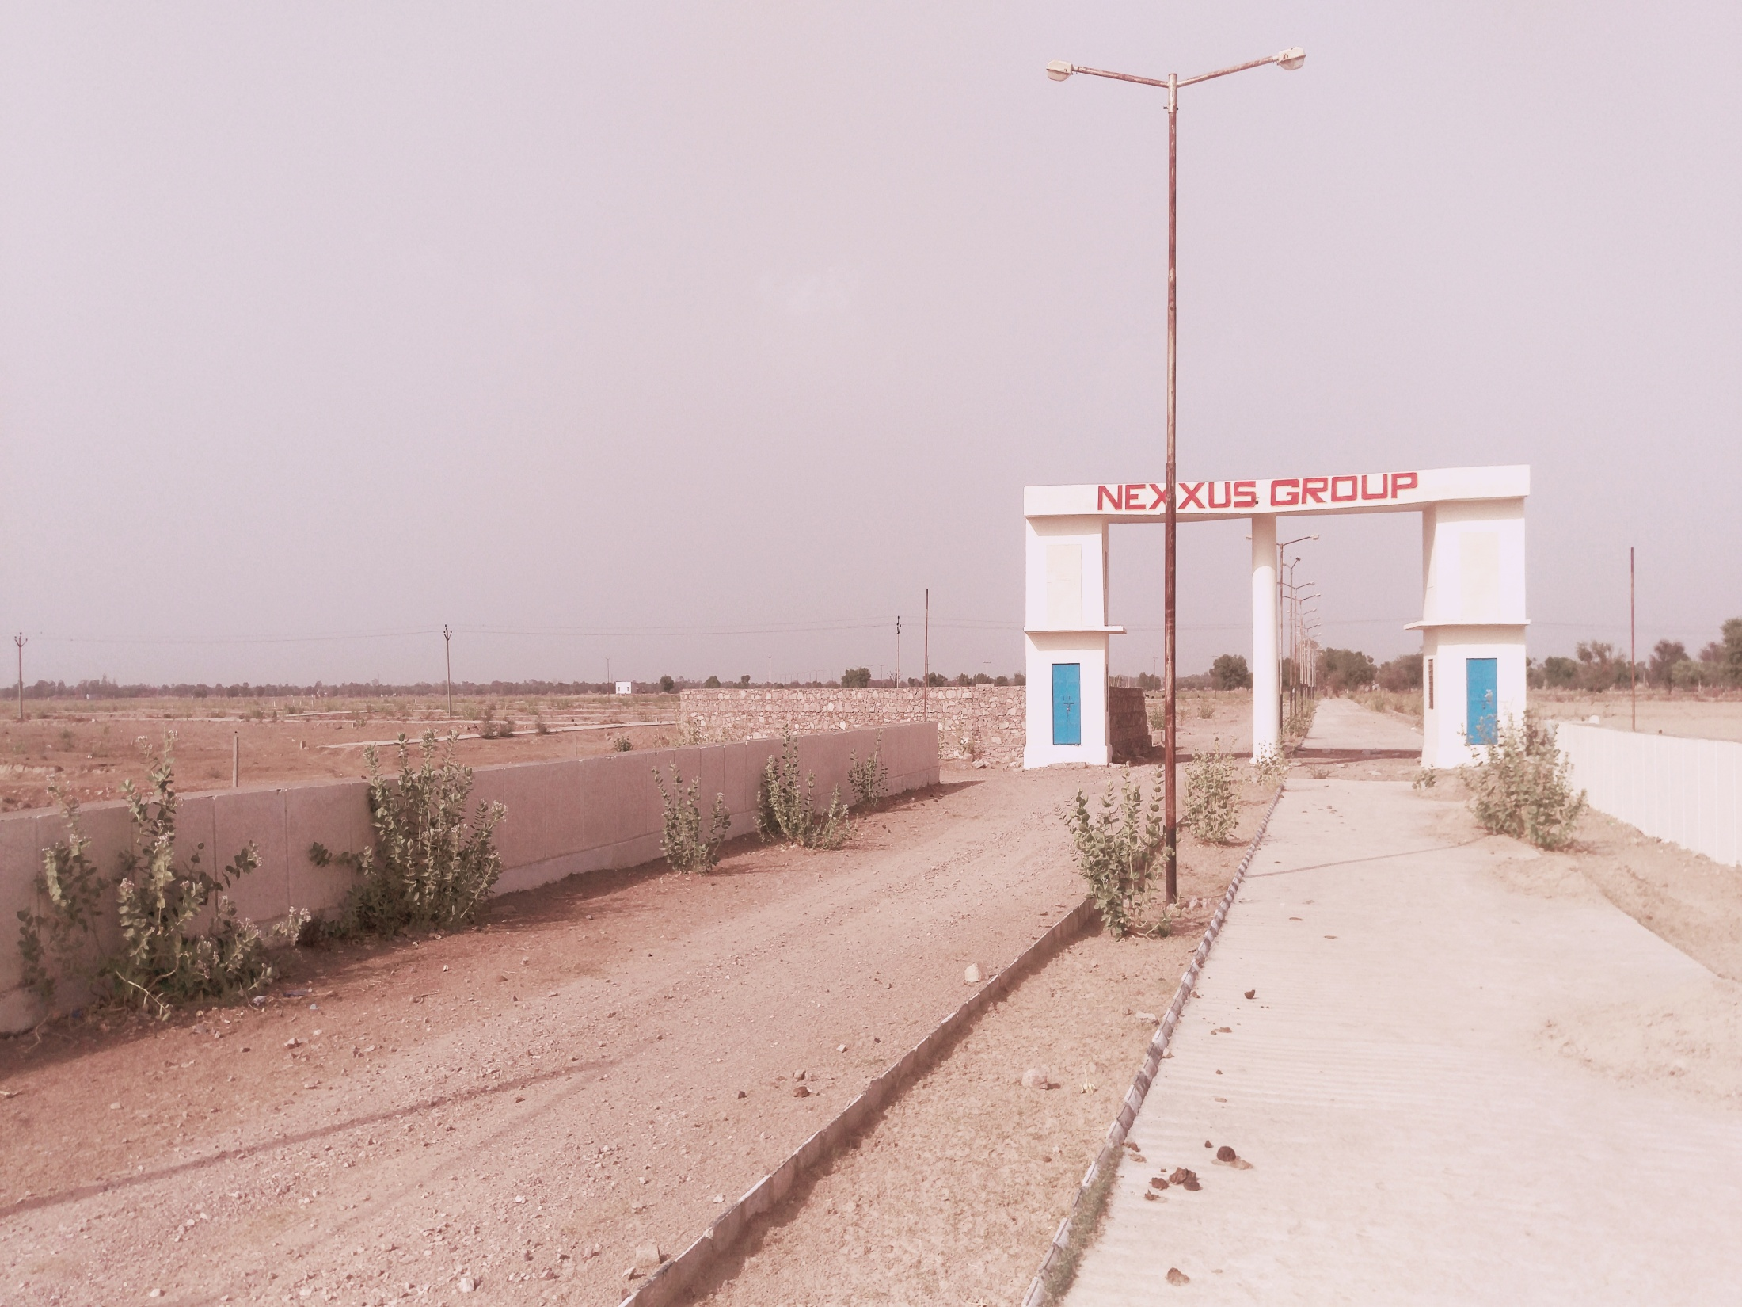

Slide 16
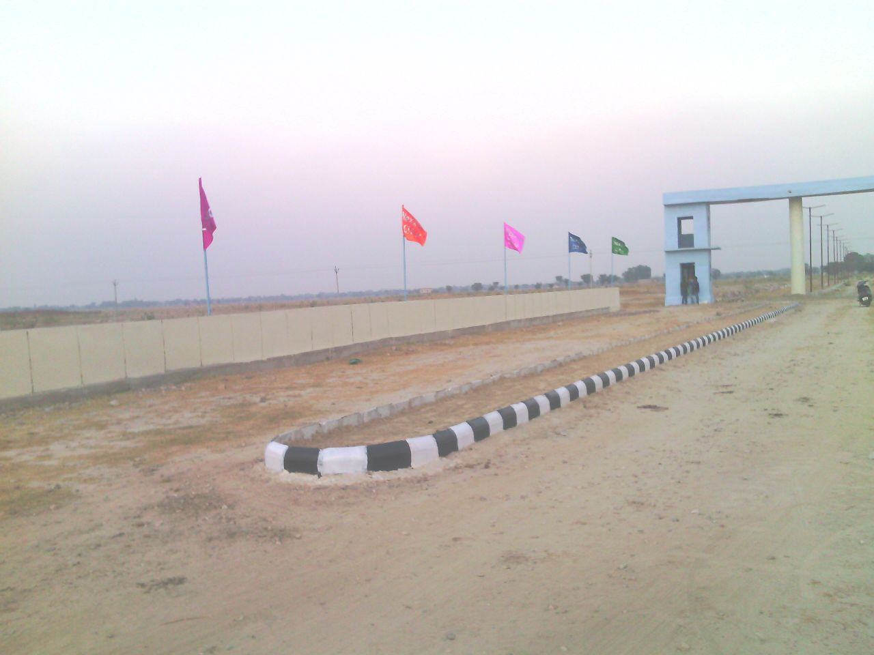
NEXXUS CITY’S ACTUAL SITE IMA

Slide 17
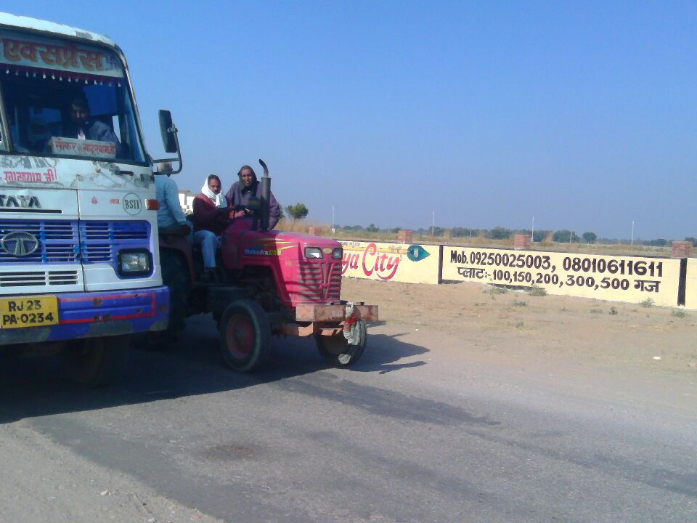

Slide 18
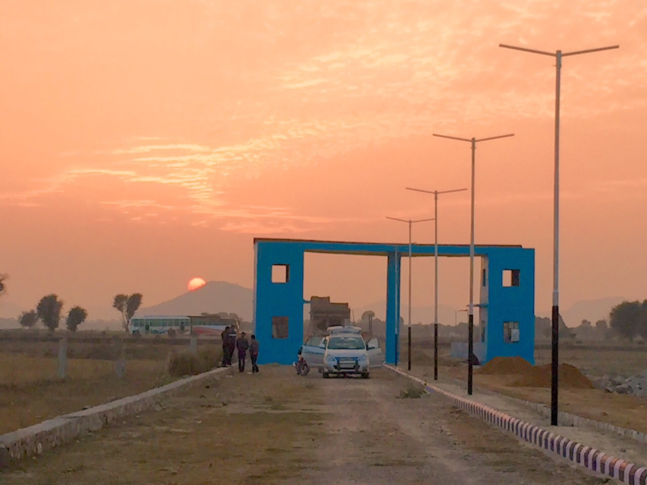

Slide 19
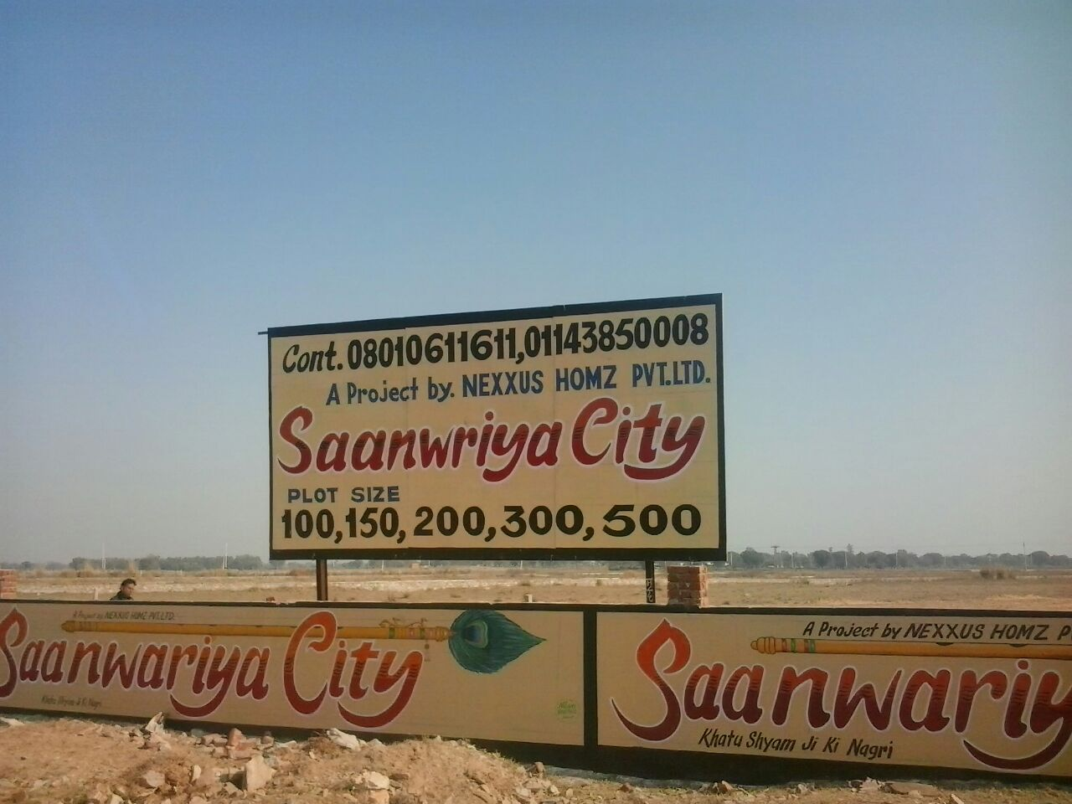

Slide 20
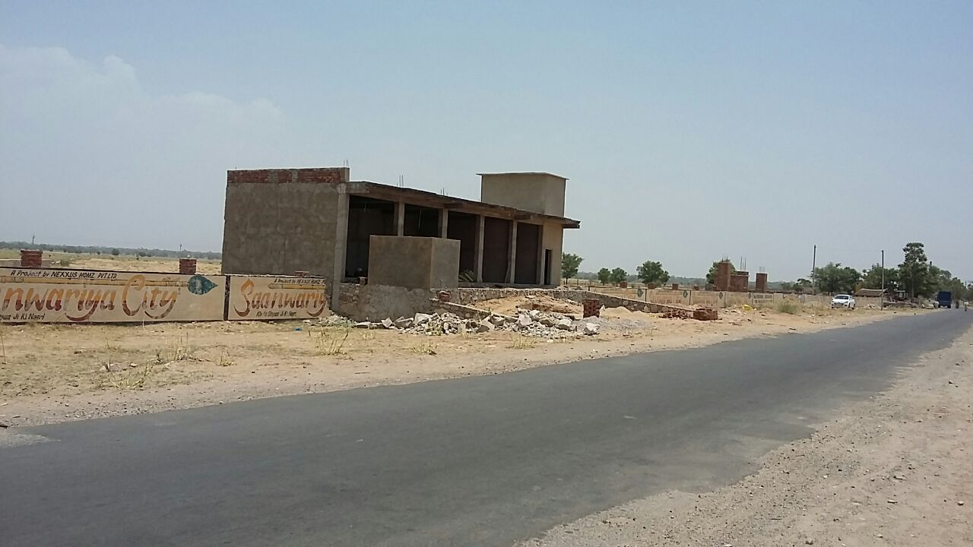

Slide 21
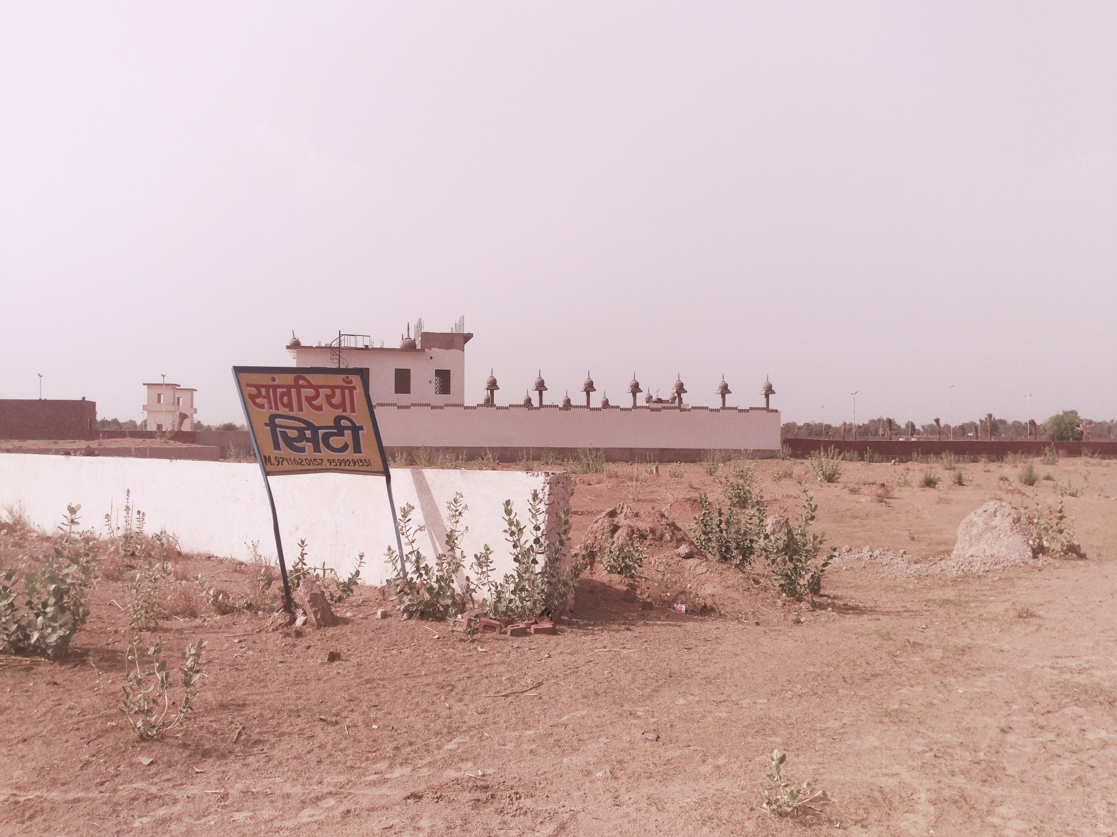

Slide 22
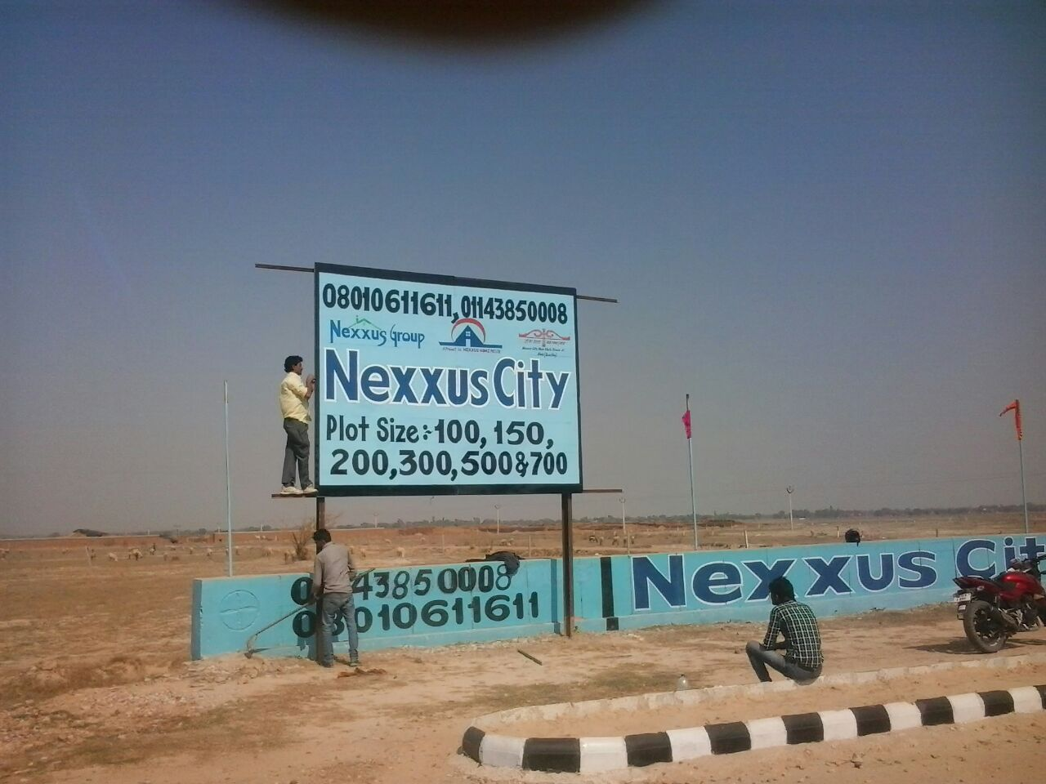

Slide 23
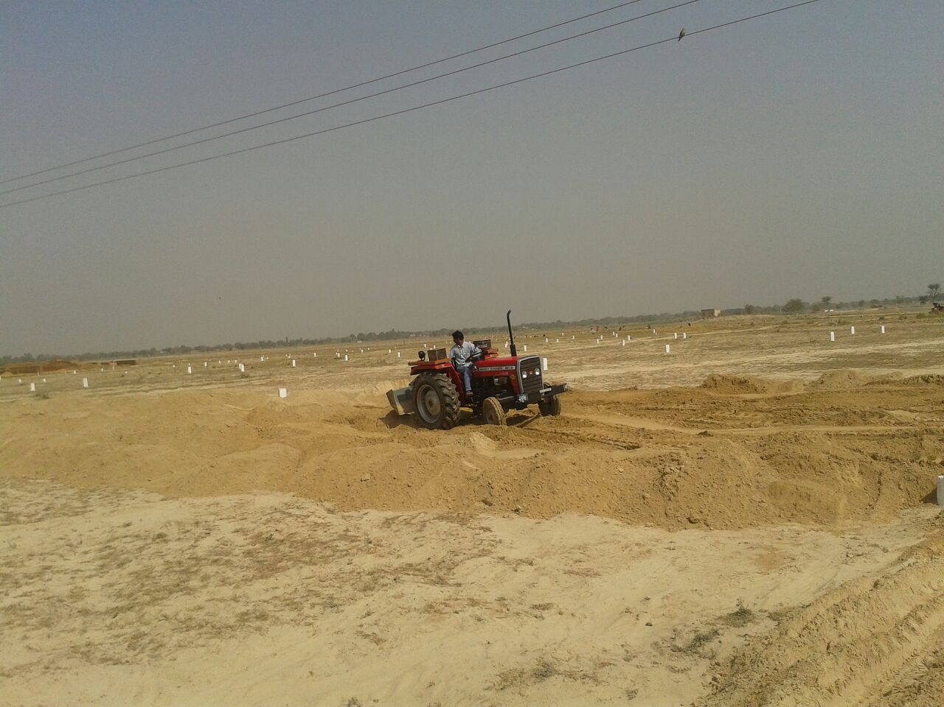

Slide 24
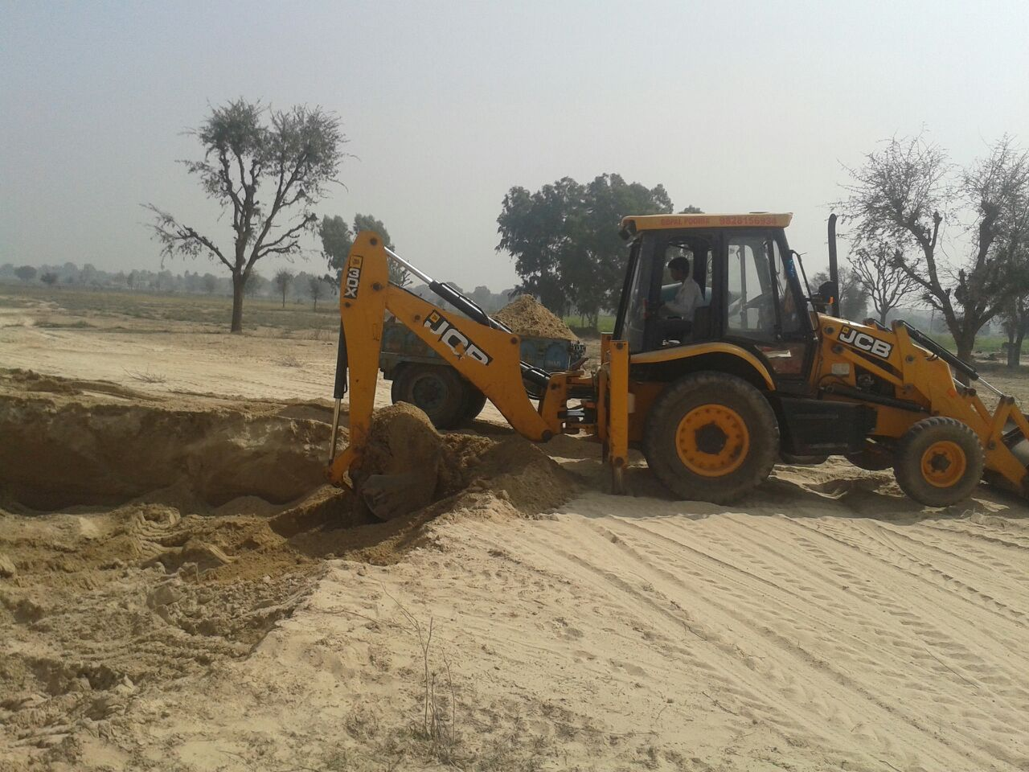

Slide 25
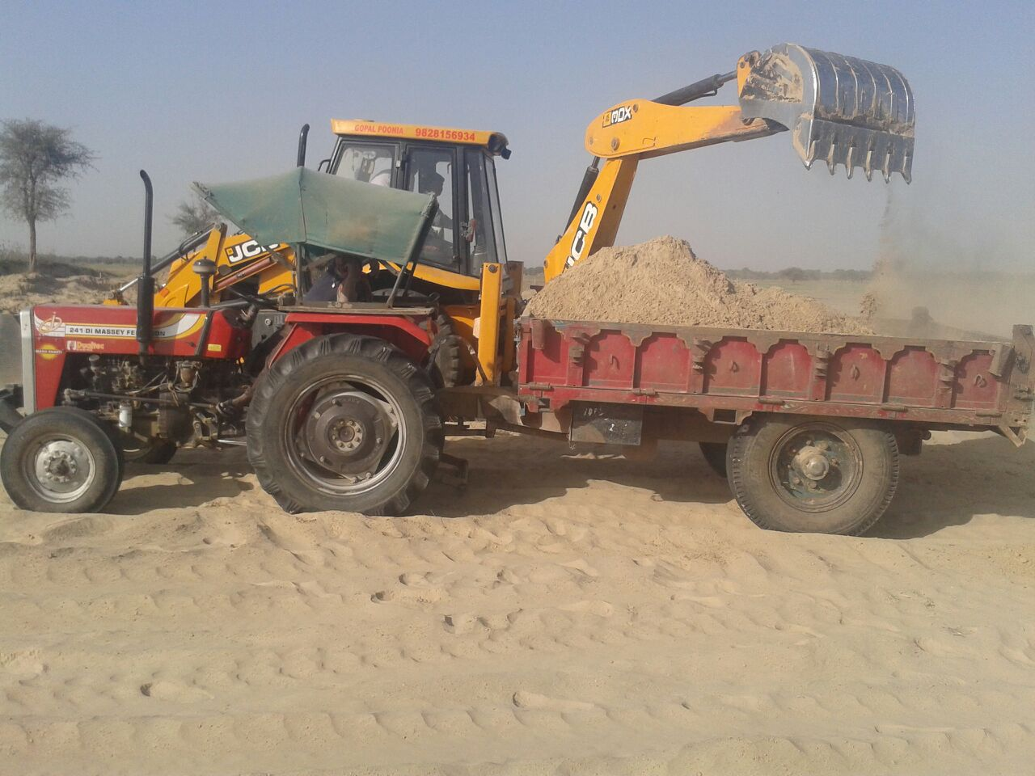

Slide 26
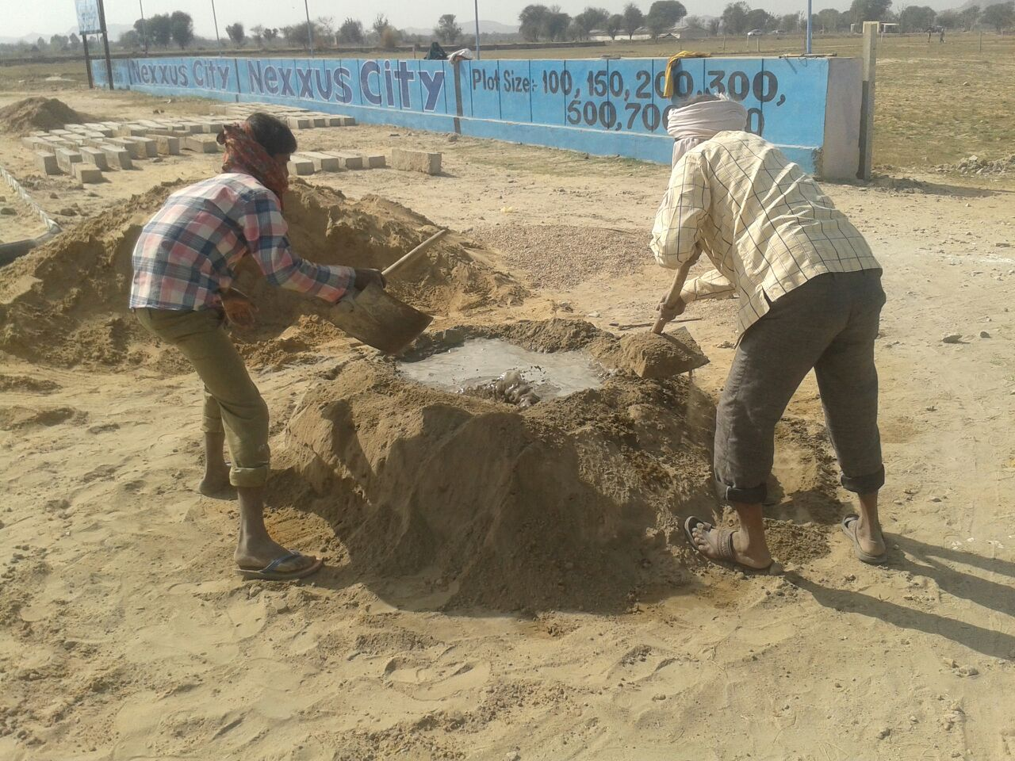

Slide 27
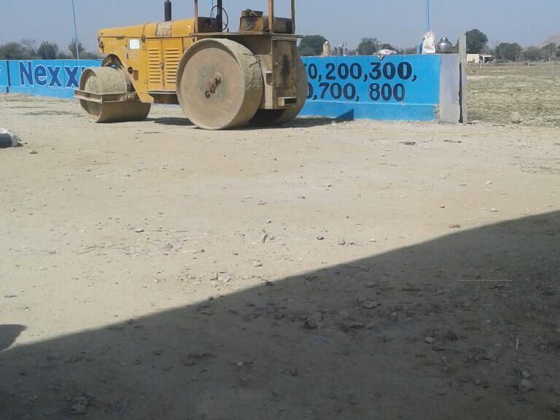

Slide 28
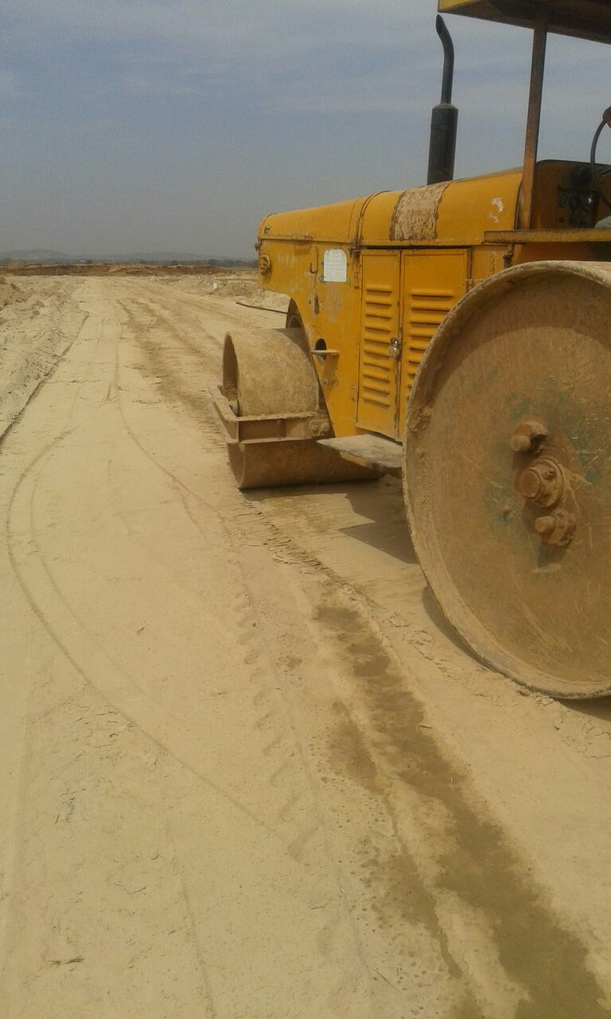

Slide 29
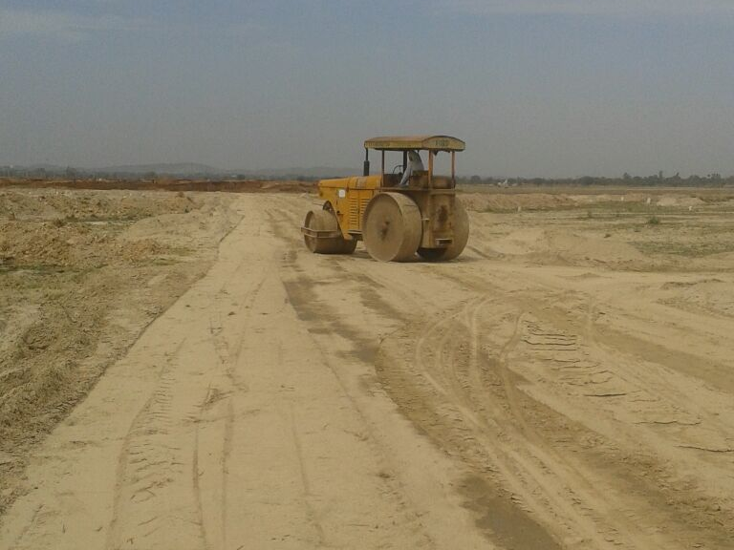

Slide 30
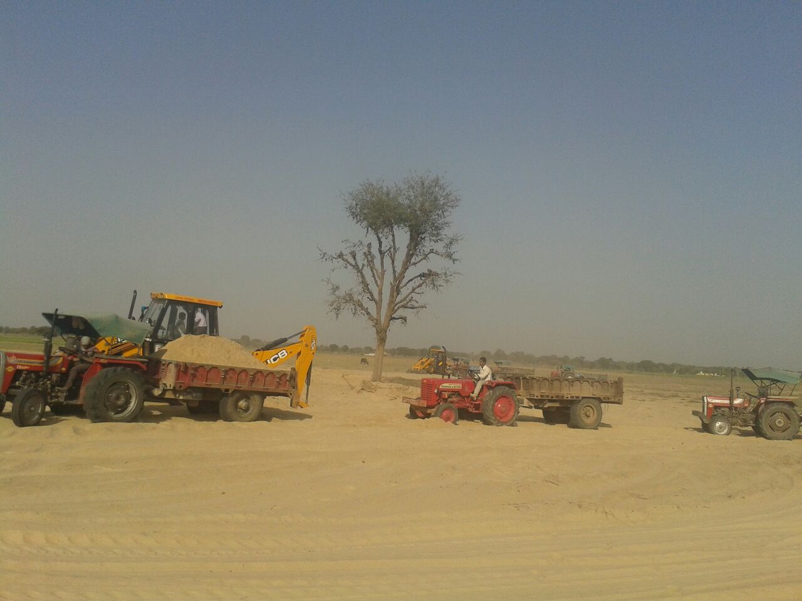

Slide 31
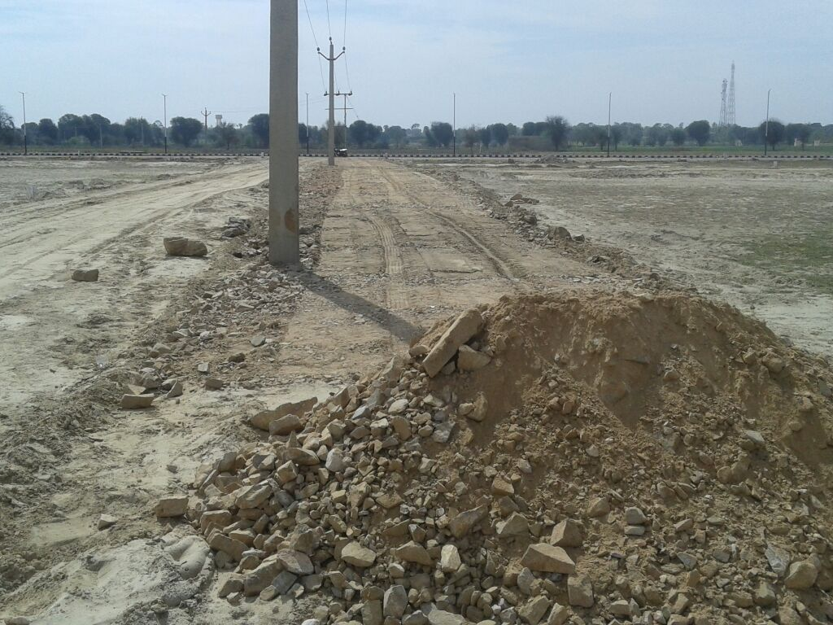

Slide 32
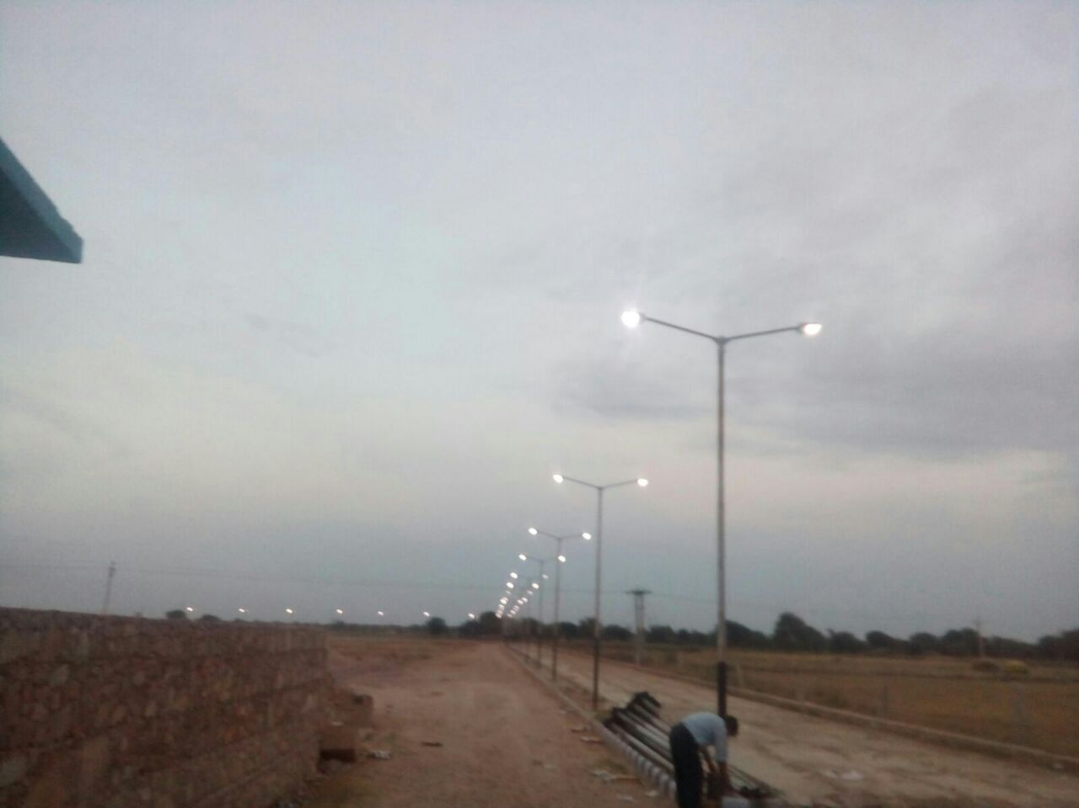

Slide 33
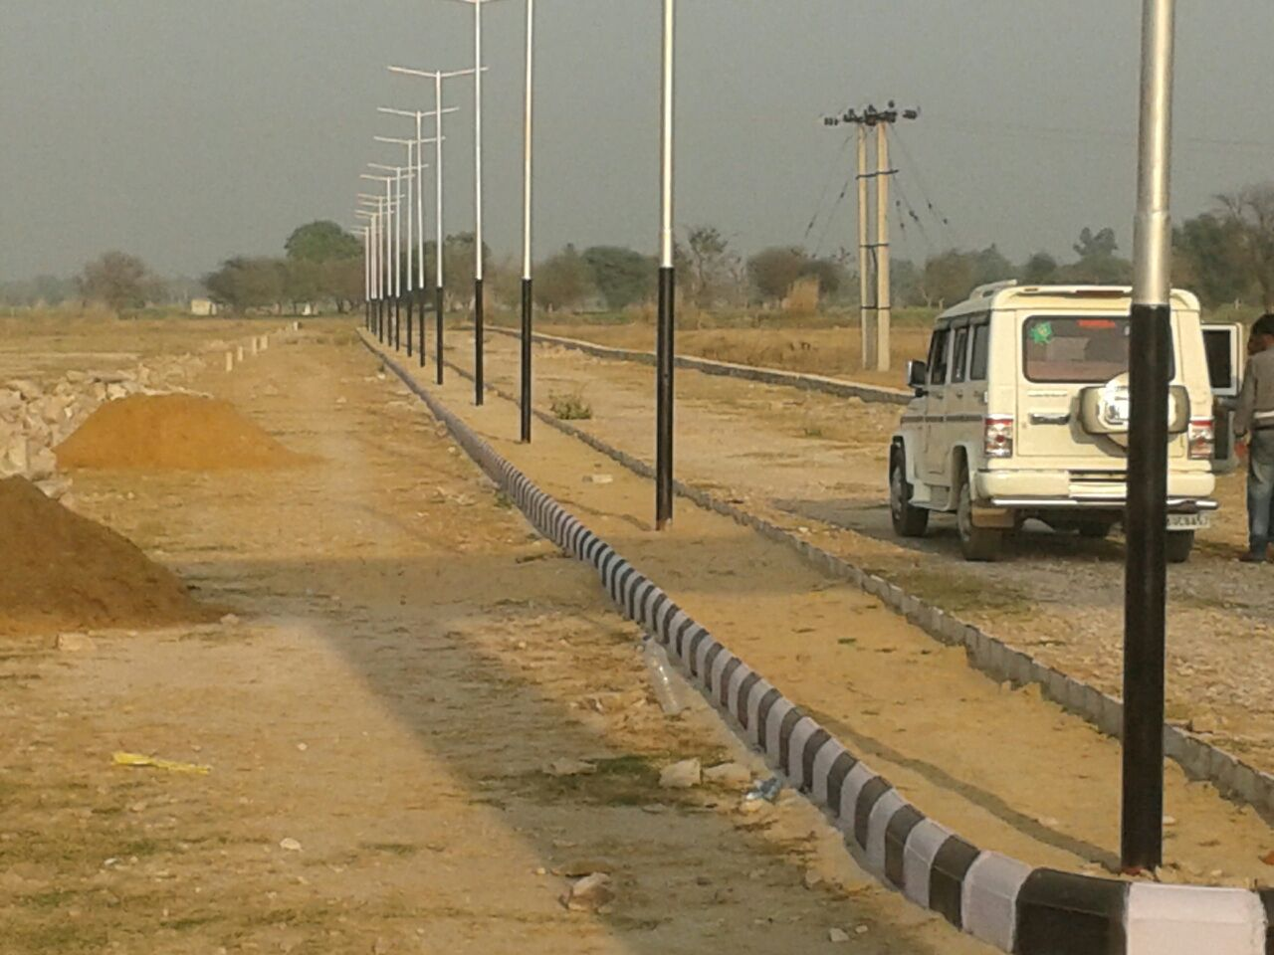

Slide 34
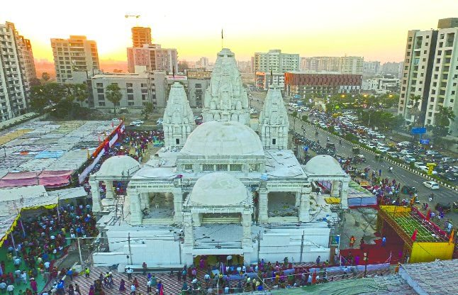
NEXXUS HOMZ PRIVATE LIMITED
Corp. Office : 406, Pearl Business Park, Netaji Subhash Palace, Pitampura, Delhi-34
Shri Khatu Shyam Ji Temple Aerial View
Contact : 09891121999,9599291350, e-mail: rakeshkant@nexxushomz.com
Site Address : Nexxus City, Khatu Palsana Road, Near Khatu Shyam Ji Temple, Tehsil - Palsana, Dist. Sikar, Rajasthan.

